Slide 1
CS 4504 Parallel and Distributed Computation Scheduling
Kun Suo
Computer Science, Kennesaw State University
https://kevinsuo.github.io/

Slide 2
Outline
What is distributed scheduling?
Monolithic scheduler
Borg
Two-level scheduler
Mesos
Shared state scheduler
Omega

Slide 3
Workloads in Datacenters (e.g., Uber)
Stateless jobs: no state, long running services
Stateful jobs: long running services but need local disk for storing their state. Such as Cassandra, MySQL, and Redis

Slide 4
Workloads in Datacenters (e.g., Uber)
Batch jobs: running minutes to days, not latency-sensitive, can be preempted by other jobs. Such as data analytics, machine learning, etc.
Daemon jobs: running on each node of the cluster. Such as Kafka, HAProxy and M3 collector.

Slide 5

Distributed Scheduling
Distributed system architecture:
Centralized structure
Decentralized structure
The purpose of the distributed system architecture is to manage multiple server resources and find the appropriate server to perform user tasks.

Slide 6
Distributed Scheduling
What is the appropriate server? Many constraints:
Task priority
Resource availability
Load balance
…
The process of finding the appropriate server in distributed systems for user tasks is called distributed scheduling

Slide 7
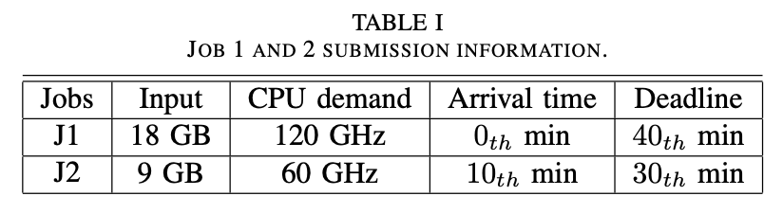
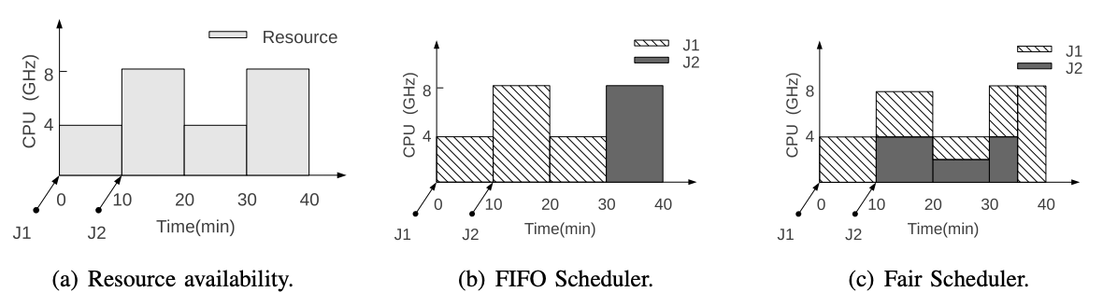
Distributed Scheduling
The scheduler is one of the most important components in distributed system. The scheduler provides multiple scheduling strategies (FIFO, SJF, etc.) and is responsible for completing specific scheduling tasks.
Hadoop

Slide 8
Distributed Scheduling
The scheduler principle of different distributed architectures is different
Kubernetes
Hadoop

Slide 9
Distributed Scheduling
The most common or intuitive scheduler is the monolithic scheduler, which matches the user task with the idle resources in the distributed systems.
Monolithic scheduler manages both tasks and resources

Slide 10

What is Monolithic Scheduler?
Only one node in a cluster runs the scheduling process.
This node can collect other node's resource information and status for unified management. According to the resource requirements of tasks, the scheduler matches tasks with available resources.
The monolithic scheduler has a global view on resource and tasks, which can easily implement task constraints and global scheduling strategies

Slide 11
Monolithic Scheduler Example
The scheduling process runs on the master node (responsible for resource management, tasks, and resource matching)
Slave nodes report “Node state” to the Cluster State on master node, which manages the resources and states of nodes in the cluster

Slide 12
Monolithic Scheduler Example
Cluster State reports resource states to Scheduling Logic module, which is responsible for matching between tasks and resources
After scheduling decision is made, the task will be sent to corresponding node in the cluster

Slide 13
Monolithic Scheduler
Monolithic scheduler is also called centralized scheduler, which manages the resources and tasks on a single node

Slide 14
How monolithic scheduler works? Using Borg as an example
Monolithic scheduler: find a match between tasks and resources
Definition of jobs:
A job is composed of batches of tasks
A job can only execute on a cluster
Definition of tasks
A task is composed of batches of processes
A task executes on a node in the cluster

Slide 15
How monolithic scheduler works? Using Borg as an example
When a user submits a job to BorgMaster, it saves the job to the Paxos warehouse and add all tasks of this job to the waiting queue.
The scheduler scans the waiting queue asynchronously and assigns tasks to computing nodes that meet constraints and have enough resources. Here the scheduling unit is task not job.

Slide 16
How monolithic scheduler works? Using Borg as an example
Feasibility check:
the scheduler will find a set of machines that meet the task constraints and have enough available resources
Suppose Job A requires to be deployed to Node 1, 3 and 5 and consumes 0.5 CPU and 2MB memory. Scheduler will first filter Node 1, 3, 5 and then select one node has 0.5 CPU and 2MB memory.

Slide 17
How monolithic scheduler works? Using Borg as an example
Rating:
Borg scores the selected machines in the feasibility check stage according to a scoring mechanism and selects the one that is most suitable for scheduling
Common scoring algorithms, including "worst fit" and "best fit"

Slide 18
How monolithic scheduler works? Using Borg as an example
Worst fit:
distribute tasks across as many as possible different machines
Possible problem: it results in a small amount of unusable remaining resources for each machine. Resource fragmentation.
T1:
0.4 CPU
0.3G memory
T2:
0.3 CPU
0.5G memory
A:
1 CPU
1G memory
B:
0.8 CPU
1.2G memory

Slide 19
How monolithic scheduler works? Using Borg as an example
Best fit:
distribute tasks across as less as possible different machines
T1 and T2 will be put onto the same server
Possible problem: is not good for applications with sudden loads and requiring immediate handling. Everything on one server causes single node failure and low reliability.
T1:
0.4 CPU
0.3G memory
T2:
0.3 CPU
0.5G memory
A:
1 CPU
1G memory
B:
0.8 CPU
1.2G memory

Slide 20
How monolithic scheduler works? Using Borg as an example
For scenarios where resources are limited, and business traffic is relatively regular, and there are basically no sudden traffic, the best fit works better;
If resources are abundant and business traffic often occurs unexpectedly, the worst fit algorithm should be used.
T1:
0.4 CPU
0.3G memory
T2:
0.3 CPU
0.5G memory
A:
1 CPU
1G memory
B:
0.8 CPU
1.2G memory

Slide 21
How monolithic scheduler works? Using Borg as an example
Besides best fit and worst fit, other possible scheduling policies include:
Priority-based
Locality-based
…
T1:
0.4 CPU
0.3G memory
T2:
0.3 CPU
0.5G memory
A:
1 CPU
1G memory
B:
0.8 CPU
1.2G memory

Slide 22
Monolithic Scheduling
Possible issues:
The central server can easily become a single point of bottleneck, which will directly lead to the limitation of the scale
Low reliability, single node failure
Limited to support jobs with different characteristics (e.g., supporting two policies at the same time? Batching jobs and latency-sensitive jobs at the same time?)

Slide 23
Monolithic Scheduling
Possible issues:
Limited to support jobs with different characteristics
E.g., supporting two policies at the same time?
E.g., batching jobs (static content) and streaming jobs (dynamic content) at the same time?
Monolithic scheduling becomes more complex as the category of jobs increases.

Slide 24

Two-level Scheduling
Two-level Scheduling: separate the resource scheduling and task scheduling

Slide 25
Two-level Scheduling
Two-level Scheduling: separate the resource scheduling and task scheduling
Layer-2 scheduler can support different scheduling policies for different types of jobs
Layer-1 scheduler manages globally and allocates resources to layer-2 scheduler
Layer-2 scheduler matches the resources with the tasks

Slide 26
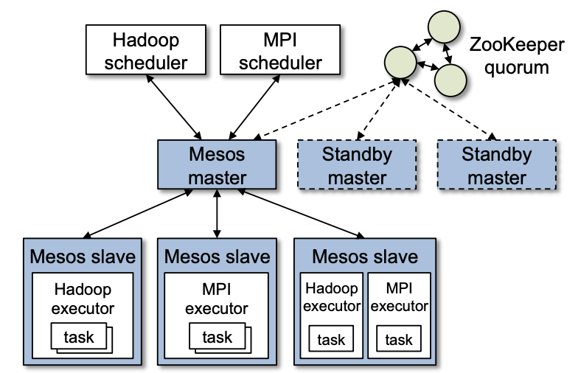
Example of Two-level Scheduling: Mesos
Two-level Scheduling
Mesos, first-level scheduling, is only responsible for the management and allocation of the underlying resources, and does not involve functions such as storage and task scheduling
The second-level task scheduling is through the framework, such as Hadoop, Spark, etc., to complete

Slide 27
Example of Two-level Scheduling: Mesos
First-level Scheduling
The resource management cluster is a centralized system composed of a master node and multiple slave nodes.
The cluster has only one master node, which is responsible for managing slave nodes and connecting to the upper-level framework
The slave nodes periodically report resource status information to the master node and execute tasks submitted by the framework.

Slide 28
Example of Two-level Scheduling: Mesos
Second-level Scheduling
Frameworks, such as Hadoop, Spark, MPI, and Marathon, run on Mesos and are "components" responsible for application management and scheduling.
Different frameworks are used to complete various tasks, such as batch tasks, real-time analysis tasks, etc.

Slide 29
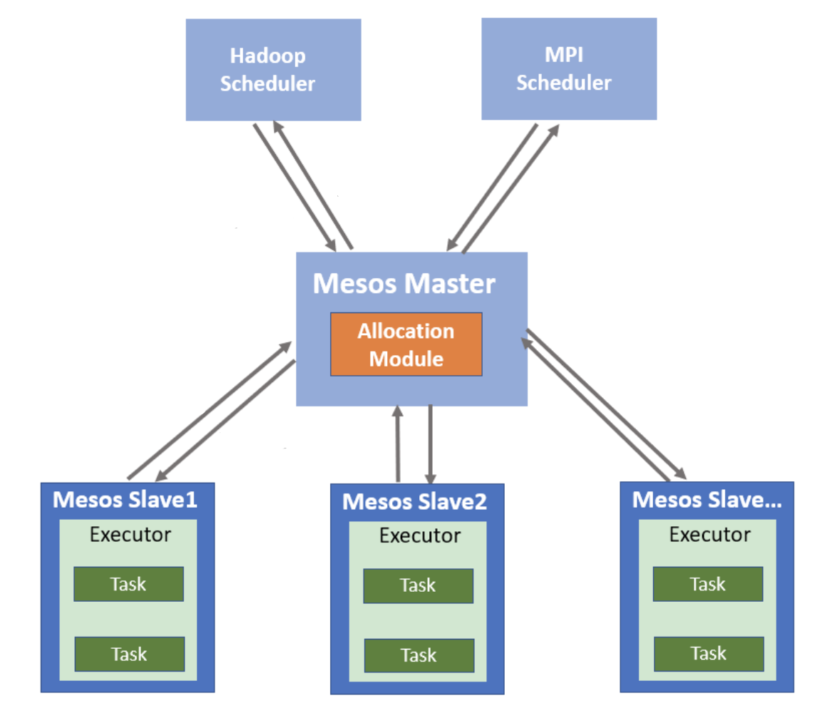
Example of Two-level Scheduling: Mesos
Workflows in Mesos
The framework registers with the Mesos Master;
The Mesos Slave node reports the free resources of the node to the Mesos Master periodically;
The Scheduler process on the Mesos Master collects the free resource information and sends it to the registered framework;
After the framework's Scheduler receives the resources, it performs task scheduling and matching. If matches, the result is sent to the Mesos Master, and then forwarded to the corresponding node's executor to execute the task.
Register
Send tasks
Submit idle resource
Submit idle resource
Send tasks

Slide 30
Example of Two-level Scheduling: Mesos
Scheduling policy in frameworks
Hadoop: http://www.corejavaguru.com/bigdata/hadoop-tutorial/yarn-scheduler
FIFO
Capacity
Fair
…
Spark: https://databricks.com/session/apache-spark-scheduler

Slide 31
Example of Two-level Scheduling: Mesos
Scheduling algorithm at the first-level:
Max-min Fairness, MMF
Dominant Resource Fairness, DRF

Slide 32
Example of Two-level Scheduling: Mesos
Max-min Fairness algorithm:
Fairly share the minimum requirements that each user needs, and then allocate the unused resources evenly to users who need extra resources.
Example
Total resource: 10
User number: 4
User requirement: 2, 2.6, 4, 5
Final allocation
2
2.6
4
5
2.5
2.5
2.5
2.5
2
2.67
2.67
2.67
2
2.6
2.7
2.7
2
2.6
2.7
2.7
0.5/3
0.07/2

Slide 33
Example of Two-level Scheduling: Mesos
Example of MMF
Total idle resource: 100
User number: 4
User requirement: 35, 10, 25, 45
Final allocation
35
10
25
45
25
25
25
25
30
10
30
30
32.5
10
25
32.5
32.5
10
25
32.5
15/3
5/2

Slide 34
Example of Two-level Scheduling: Mesos
Problems of MMF
Allocating resources in an absolutely fair way will cause a lot of waste of resources
For example, user A and user D with user demand of 35 and 45 are all allocated 32.5 free resources, but because the resources do not meet the demand, both users cannot use and run tasks.
Final allocation
35
10
25
45
25
25
25
25
30
10
30
30
32.5
10
25
32.5
32.5
10
25
32.5
15/3
5/2

Slide 35
Example of Two-level Scheduling: Mesos
Dominant Resource Fairness, DRF
Besides the fairness among users, it also considers the needs of users for different types of resources
Can satisfy as many users as possible

Slide 36
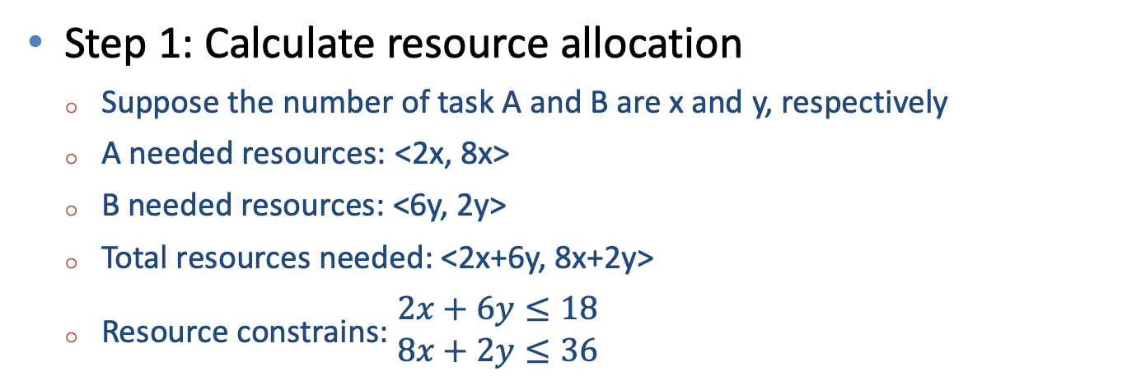
Example of Two-level Scheduling: Mesos
Dominant Resource Fairness Case
Suppose we have 18 CPUs and 36GB memory
A: memory-bound task, <2 CPU, 8 GB>
B: CPU-bound task, <6 CPU, 2 GB>
Step 1: Calculate resource allocation
Suppose the number of task A and B are x and y, respectively
A needed resources: <2x, 8x>
B needed resources: <6y, 2y>
Total resources needed: <2x+6y, 8x+2y>
Resource constrains: $\begin{matrix}2x+6y≤18 \\ 8x+2y≤36\end{matrix}$

Slide 37
Example of Two-level Scheduling: Mesos
Dominant Resource Fairness Case
Suppose we have 18 CPUs and 36GB memory
A: memory-bound task, <2 CPU, 8 GB>
B: CPU-bound task, <6 CPU, 2 GB>
 | CPU | Memory
A | 2x/18 | 8y/36
B | 6x/18 | 2y/36
Step 2: Define the main resource limitation for each task
For each A, it needs 2/18 system CPU, 8/36 system memory, so memory limits A’s number
For each B, it needs 6/18 system CPU, 2/36 system memory, so CPU limits B’s number

Slide 38
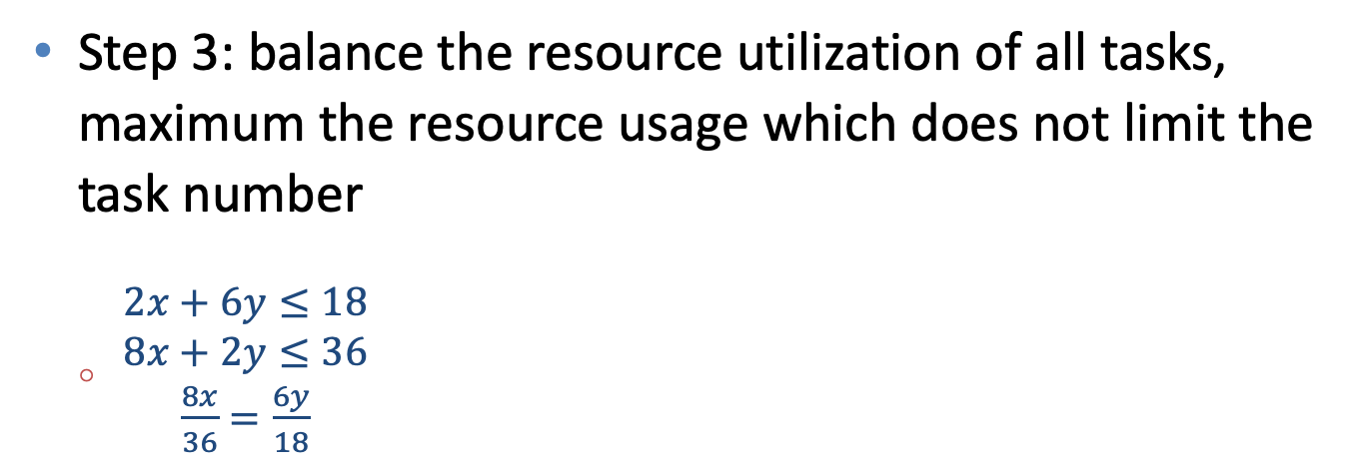
Example of Two-level Scheduling: Mesos
Dominant Resource Fairness Case
Suppose we have 18 CPUs and 36GB memory
A: memory-bound task, <2 CPU, 8 GB>
B: CPU-bound task, <6 CPU, 2 GB>
 | CPU | Memory
A | 2x/18 | 8x/36
B | 6y/18 | 2y/36
Step 3: balance the resource utilization of all tasks, maximum the resource usage which does not limit the task number
$\begin{matrix}2x+6y≤18 \\ \begin{aligned}8x+2y≤36 \\ \frac{8x}{36}=\frac{6y}{18}\end{aligned}\end{matrix}$
X=3
Y=2
A consumes 2/3 of memory resource
B consumes 2/3 of CPU resource

Slide 39
Example of Two-level Scheduling: Mesos
Max-min Fairness algorithm:
Suitable for a single type of resource allocation scenario
Assign no more resources than required to each user
Dominant Resource Fairness algorithm
Suitable for scenarios where multiple types of resources are mixed
Make the most use of resources so that as many tasks as possible can be performed

Slide 40
Two-level Scheduling
Possible issues:
Decouple the task scheduling with the resource availability might make frameworks only know part of the resource information and cannot guarantee global optimal

Slide 41
Shared state scheduling -- Why
Two types of objects to be managed in the cluster:
Resource allocation and usage status;
Task scheduling and execution status;
Monolithic scheduling manages the two at the same time:
+ Global resource management
- Poor scalability and single node bottleneck

Slide 42
Shared state scheduling -- Why
Two types of objects to be managed in the cluster:
Resource allocation and usage status;
Task scheduling and execution status;
Two-level scheduling manages the two at different levels:
- Cannot provide optimal resource in global scope
+ Good scalability

Slide 43
Shared state scheduling
Break down a single scheduler into multiple schedulers
--> Better scalability and no single node failure
Each scheduler has global resource status information
--> Optimal task scheduling

Slide 44
Architecture of Shared State Scheduling
State storage:
Responsible for storing and maintaining resource and task state, so Schedulers can query available resource when scheduling tasks

Slide 45
Architecture of Shared State Scheduling
Resource Pool:
Multiple node clusters that receive and execute tasks scheduled by the Scheduler; send state of resources and job execution to the Storage

Slide 46
Architecture of Shared State Scheduling
Scheduler:
Just for concrete task scheduling operations

Slide 47
Monolithic vs. Shared State Scheduling
Different from the monolithic scheduling, the Scheduler in shared state scheduling does not need to manage the cluster resources

Slide 48
Two-level vs. Shared State Scheduling
All schedulers in shared state scheduling can access the resource information directly and make optimal scheduling on a global view

Slide 49
Example of Shared State Scheduling
Google Omega: https://storage.googleapis.com/pub-tools-public-publication-data/pdf/41684.pdf
Microsoft Apollo: https://www.usenix.org/system/files/conference/osdi14/osdi14-paper-boutin_0.pdf
Hashicorp Nomad: https://www.nomadproject.io/

Slide 50
Example of Shared State Scheduling: Omega
Cell: a group of servers
A cluster can have multiple cells
State storage: store and maintain the states of resources and tasks
Cell State: records the global cluster states
Every scheduler has one copy of the Cell State → sharing the state of the cluster
Omega architecture

Slide 51
Example of Shared State Scheduling: Omega
What will happen when two scheduler try to use the same resource?
Omega adopts transaction model in database to maintain the consistency and atomicity for the same resource
In database, only one query can update one record at one time
Omega architecture

Slide 52
Example of Shared State Scheduling: Omega
The scheduler tries to match the tasks and resources
Scheduler will check whether the resources have been used during the checkpoints
Match between tasks and resources
All tasks are matched
Available resources
Tasks waiting for schedule
Non-Available resources
Scheduled tasks

Slide 53

Comparison
A central scheduler manages the resource information and task scheduling of the entire cluster. All tasks can only be scheduled by the central scheduler
Parts of resource information
All resource information
Adv: global optimal
Disadv: No scheduling concurrency, single point bottleneck problem, only suitable for small-scale clusters

Slide 54
Comparison
The resource management and task scheduling are divided into two layers for scheduling. The first layer scheduler is responsible for cluster resource management and sends the available resources to the second layer scheduling.
Parts of resource information
All resource information
Adv: no single point bottleneck and higher scalability
Disadv: 2rd level scheduler only has parts of the resource information and cannot provide

Slide 55
Comparison
Multiple schedulers, each scheduler can see the global resource information of the cluster through state sharing
Parts of resource information
All resource information
Adv: Each scheduler can obtain global resource information in the cluster, so the task matching algorithm can achieve global optimality
Disadv: multiple scheduler might cause resource competition and conflict

Slide 56
Conclusion
 | Monolithic scheduling | Two-level scheduling | Sharing state scheduling
Architecture | Centralized, one node | Two schedulers | Distributed, multiple schedulers
Unit | Task | Task | Task
Parallel scheduling | No | Yes | Yes
Global optimal | Yes | No | Yes
Performance | Sharing state scheduling > Two-level scheduling > Monolithic scheduling
Scalability | Sharing state scheduling > Two-level scheduling > Monolithic scheduling
Suitable scenario | Small cluster | Medium cluster | Large scale cluster
Example | Borg | Mesos, YARN | Omega

